Slide 1
CANCER DETECTION USING MACHINE LARNING
ARUN DHAKAD 17BCS4131
ASHISH 17BCS4134
ADNAN 17BCS4141
RISHABH 17BCS4143
DEEPANSHU 17BCS4145

Slide 2
OBJECTIVE
To Predict the Cancer Type using various values like clump_thickness, uniform_cell_size, uniform_cell_shape, marginal_adhesion, single_epi_cell_size, bare_nuclei, bland_chromation, normal_nucleoli, mitoses and classes.

Slide 3
Tool Required
Windows 10
Python IDLE 3.7
Minimum 2GB RAM
Python Modules (Tkinter,numpy,sklearn…etc)

Slide 4
FUTURE SCOPE OF THE PROJECT
Pathologists have been performing cancer diagnoses and prognoses for decades. Most pathologists have a 96–98% success rate for diagnosing cancer. They’re pretty good at that part.
The problem comes in the next part. According to the Oslo University Hospital, the accuracy of prognoses is only 60% for pathologists. A prognosis is the part of a biopsy that comes after cancer has been diagnosed, it is predicting the development of the disease.
It’s time for the next step to be taken in pathology.
Machine Learning (ML) is one of the core branches of Artificial Intelligence. It’s a system which takes in data, finds patterns, trains itself using the data and outputs an outcome

Slide 5
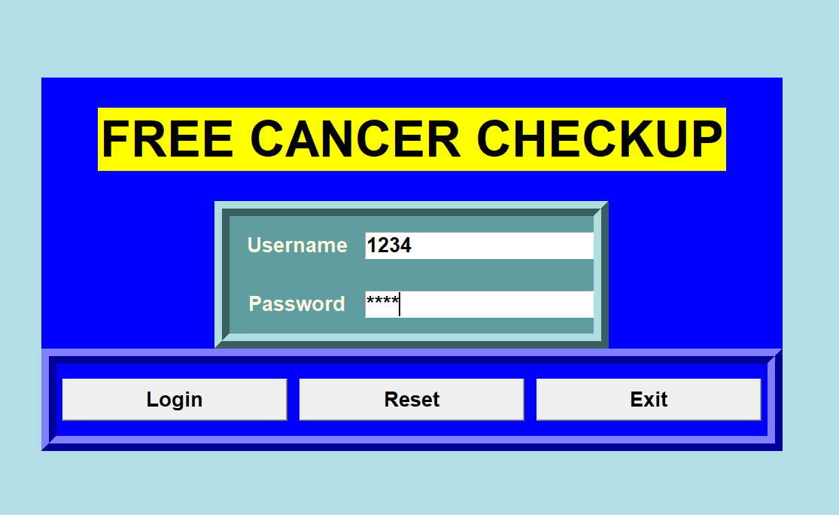
Types of module we use..
We use many Modules
Tkinter– for Designing.
Numpy– for read data as array
Sklearn – It is machine learning module in which we predict the type of cancer.

Slide 6
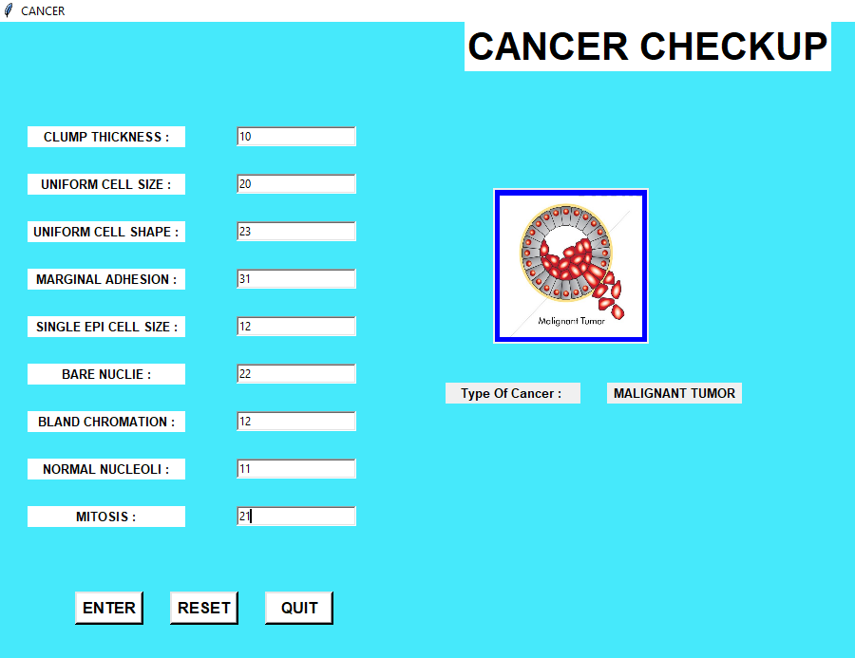
FINDING CANCER TYPE
Entering various values to predict the Cancer.
In that basically we find two type of cancer Benign Tumor and Malignant Tumor

Slide 7
Reference
www.google.com
https://www.python.org/downloads
https://www.geeksforgeeks.org/machine-learning
https://www.engpaper.com/cancer-prediction-using-data-mining-techniques.htm
https://www.kaggle.com/
https://www.quandl.com/

Slide 8


